Slide 1
Huffman Encoding
Andrew Dennison
Chris Reid
Adam Fehse

Slide 2
Data Structures

Slide 3
HuffmanNode
- A modified tree node object maintaining structural standards such as a field for the nodes relevant data and variables referencing its own left and right children nodes. The added frequency variable tracks individual character frequencies in a dataset
inputString = {“Hello”} -> freqs{ [1:(h,e,o)] , [2 : l] }
- Optimized for efficiency, its methods for referencing child nodes, accessing all instance variables, comparison and leaf node identification all run perform in O(1) time.
- Nodes are managed in a priority queue to facilitate construction of the HuffMan Tree, where nodes with lower frequencies are prioritized to ensure optimal structure for data compression.

Slide 4
PriorityQueue
- Uses a minHeap array implementation to organize character frequencies, stored in customized HuffmanNode objects,
- Prioritizes nodes with lower frequencies (i.e. the root is the LEAST frequent character)
- By a resizing check preceding the primary insertion process, a doubling strategy is used to dynamically resize the array at max capacity
- Basic left/right child & parent node check and getter methods run in O(1) time.
- Insertion and deletion operations both have worst case runtimes of O(log N), due to the heap restoration process carried out by the swimUp() and sinkDown() methods.
- Total space complexity is O(n) where n is the number of HuffmanNodes present in any given priority queue

Slide 5
HashTable <K, V>
- An array based implementation using separate changing of linked lists to handle collisions
- Uses genetics to handle input versatility: {<Character, Integer>, <Character, Strip>}
- Basic get() and put() operations perform at worst in O(n) time should all characters be mapped to the same index. This is avoided by separate indexing via hashing increasing the potential for a more uniform distribution
- In the event an index contains multiple keys, a chain of linked lists organizes them in a linear fashion, requiring a linear traversal of the list (e.g. findEntry() ) if not recognized as the first node. This results in an O(N/M) average runtime which simplifies to O(N).
- Optimal conditions would have get() and put() run in constant time/ O(1) but depend on the hash functions ability to manage collisions properly
- Initial space complexity is proportional to the specific capacity and each additional entry is a linear increase. Thus, the space complexity is O(n), where n is the number of entries.

Slide 6
Encoding

Slide 7
Building a Huffman Tree
Analyze the frequencies of characters within a given input string
Store frequencies in a Hashtable
Build a HuffmanNode tree recursively from the minimum frequencies of characters.
Use a Priority Queue to keep the next two smallest frequencies at hand
Store the path from the root to each leaf node back into a HashTable corresponding to a character
O(N) time to process the frequencies from expected O(1) hashtable operations
O(M) to build the tree, where M is the number of unique characters. M is <= N
O(NlogN) to build tree with logN time to restore heap after retrieving min
O(N) to process each leaf node back into a Hashtable

Slide 8
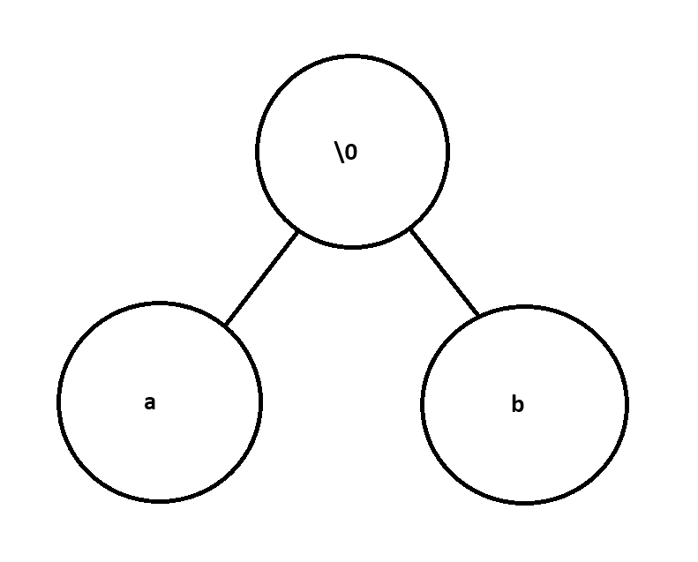
Sample Huffman Tree
String input = “abab”;

Slide 9
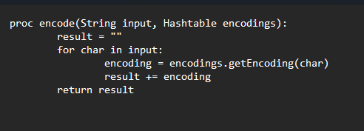
Encoding in a String
Parse each character of the input String, and retrieve the encoding as a String of 1s and 0s from the final hashtable
O(N) time assuming O(1) hashtable operations

Slide 10
Encoding Space Complexity
Three structures are used, 2x Hashtables, 1x HuffmanTree and 1x Priority Queue
All four have an O(N) space complexity
We never have more than two structures held in memory at any time
After frequencies are loaded into a priority queue, the hashtable can be discarded
After the priority queue is built into a huffman tree, the queue can be discarded
The tree and the hashtable of final encodings must be held together
The tree is then held onto after encoding and passed to decoding

Slide 11
Encoding to Bits
Because we are encoding in a String as 1s and 0s, we only need to read each 1 and 0 as a bit instead of a String, then store it in an Integer.
Obtain the bits same as before, then perform a bitwise OR to store the bit into an integer.
Encode from left to right (most significant bit to least significant bit)
If each character has exactly a one-bit encoding, we can store 32 characters in a single integer.

Slide 12
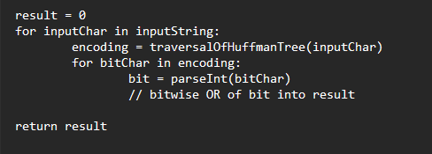
Encoding to Bits Time Complexity
After getting the String encoding from the Hashtable for a particular character, we now read the String char-by-char and parse it as a 0 or 1.
Thus, our time complexity for encodeBits changes to O(NM).
N is the length of the input String
M is the length of the encoding for one character of the input String
Because we expect expect M to be proportional to logN, determined by the encoding of the Huffman tree, we can say we expect this is O(NlogN)

Slide 13
Additional Considerations
If we run out of space in the integer array (require more than 32 bits to encode), we must resize the array.
This is an O(N) operation because we increase the size of the array by 1, then copy over each integer.
We must do this because if we double the size of the array for an amortized O(1) cost, we could end up with multiple integers with the value of 0 at the end, but no way to track which are part of the sequence and which are unmodified.

Slide 14
Encoding to Bits Space Complexity
We only need to store an Array of integers proportional to the size of the input string, O(N), in addition to retaining the Huffman Tree.
We must store one additional integer marking the size of the input String.

Slide 15
Encoding to Bits Example
Input String: “bababa”
Huffman Tree: ‘a’ on the left (0), ‘b’ on the right (1)
Bit encoding: 101010
However, this is only six bits, and an integer is always 32 in Java! Furthermore, bitwise operations cannot be done at the byte level without an integer intermediary, so it makes more sense to leave the integer representation as is.
Lastly, the maximum space we can save by encoding in bytes instead of an int is the difference in size between an integer and a byte for the last integer/byte only.
(32 - 8) = 24 bits.
Let’s encode in integers!

Slide 16
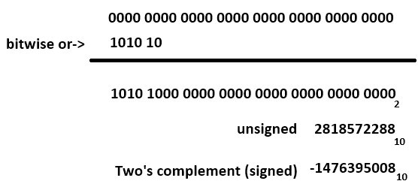
Encoding to Bits Example
It’s hard to tell where the encoding ends! The last bit we added was a 0, so how can we tell which 0 is an encoded bit and which is fluff?

Slide 17
Encoding to Bits Example
Thus, we use the first int to encode the number of characters.
This limits the length of the String we can encode to the maximum size of an Integer in Java, which is signed.
In this example, we encode the number 6 in the first int:
int[] encoding = new int[] {6, -1476395008};
int[] encoding = new int[] {0x6, 0xA8000000};

Slide 18
Space Savings
Using our earlier example, assume we have an integer consisting of 32 bits, each corresponding to a char encoded in 1 bit.
In Java, char primitives require 2 bytes, or 8 bits, of space. Thus, considering minimal usage and best case, we can encode 8x more data using Huffman Encoding than if we stored an array of characters.
This space difference grows when the fact Strings are Objects is considered, not purely a char array. Eliminate the extra space!
Additionally, we only need one integer to store the length of the input String.
https://www.javamex.com/tutorials/memory/string_memory_usage.shtml

Slide 19
Decoding

Slide 20
Decoding from String
Must be given a HuffmanNode as the root, representing a Huffman Tree
For example, a tree where the only two characters are ‘a’ and ‘b’, and both had the same frequency in the input string

Slide 21
Decoding from String (cont.)
Decoding the String “10” then involves reading each character one-by-one
Each character of the String is parsed as an Integer, either 0 or 1.
The read character corresponds to a traversal, where 1 is right and 0 is left
Thus, the input string “10” corresponds to “ba”

Slide 22
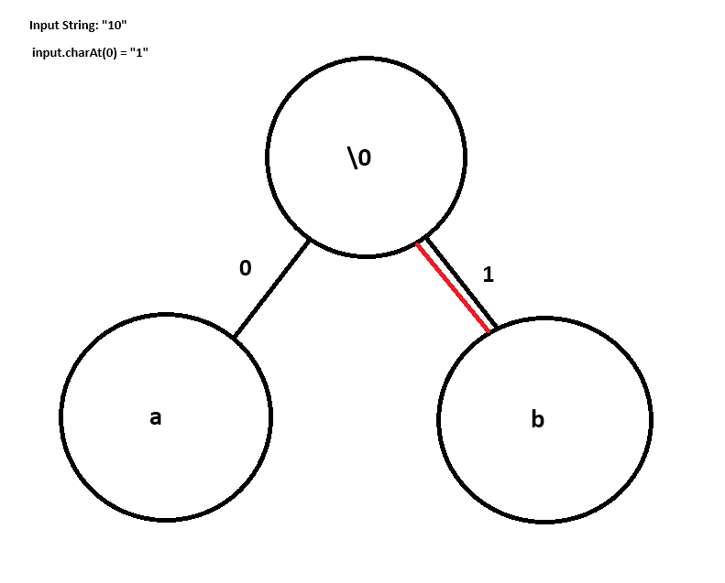
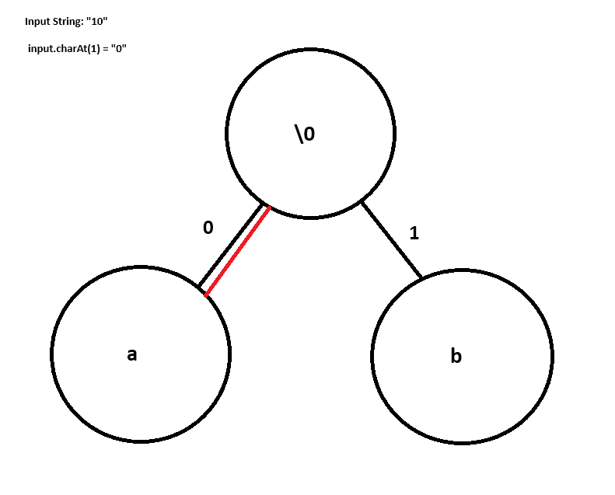
Decoding from String (cont.)
Result = ‘b’ + ‘a’ = “ba”

Slide 23
Decoding from Bits
Using the same principle, we can read an integer encoded in bits to follow a similar pattern.
However, unlike with a String, we cannot simply read until all 1s and 0s have been processed, because Integers have a fixed size of 4 bytes (32 bits).
This means we could have extra values in the integer that are unused in the encoding.
Thus, we read the first integer as “charsLeft”, and decrement each time we reach a leaf node.

Slide 24
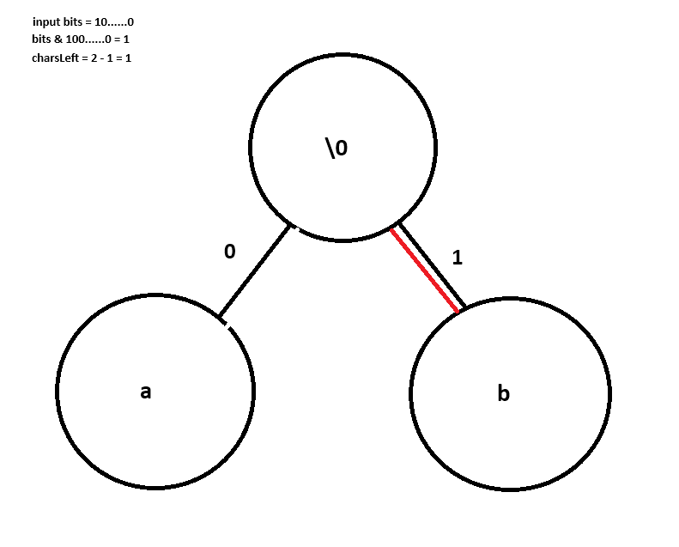
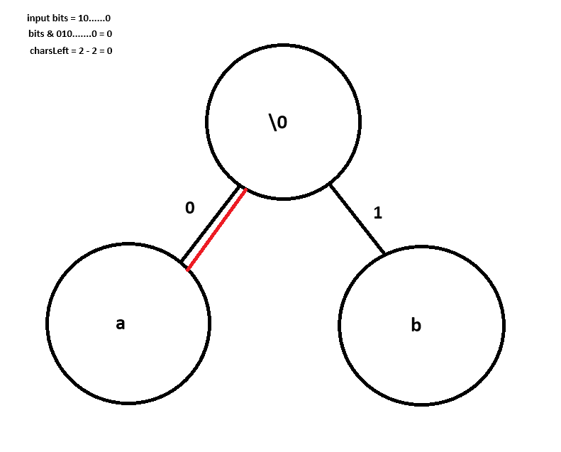
Decoding from Bits Example

Slide 25
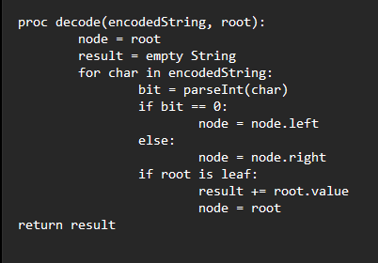
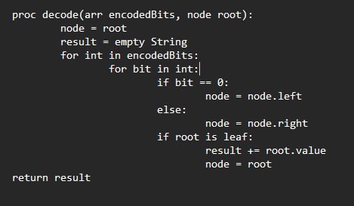
Decoding Time Complexity
Whether a String or integer array, we can determine decoding is O(N)
We either bitmask or call charAt to obtain our current bit, which are both O(1)
Then, we make one move in the tree, which is again O(1)
If we’ve reached a leaf node, append the value of that node, and reset to the head in O(1)
Repeat for each bit in the array / char in the String

Slide 26
Decoding Space Complexity
Decoding requires no additional structures, just the space to store the result and the two input parameters (HuffmanTree and input Array/String)
Thus, we can say the space complexity to run a decode algorithm is constant additional space while the algorithm runs.

